Slide 1
CGB1201 – JAVA PROGRAMMING PROJECT REVIEW-2
Department of Computer Science and Engineering
Academic Year: 2024 – 2025 (Odd Semester)
Register Number :8115U23AM057
Name :VIGNESH R
Year :2023-2027
Semester :III
Section :
Date :

Slide 2
Title of the Project
FITNESS TRACKER APPLICATION

Slide 3
Abstract
A Fitness Tracker Application is a software tool designed to help users monitor and improve their health and fitness levels. The application can track various parameters such as steps taken, distance traveled, calories burned, and workout duration. It provides users with real-time feedback and stores historical data to analyze progress over time. The application aims to motivate individuals to achieve their fitness goals through goal-setting, reminders, and data visualization. It can be enhanced with additional features like social sharing, custom workouts, and integration with wearables.

Slide 4
Abstract with CO/PO Mapping
Abstract | CO | POs | PSO
Fitness tracker applications are widely used to promote health and wellness by tracking physical activity, sleep, and vital statistics. These apps help users set fitness goals and maintain healthier lifestyles. However, challenges such as data accuracy, user engagement, and privacy concerns persist. This study explores the effectiveness of fitness trackers, analyzing their benefits and limitations while suggesting improvements in technology and security to enhance user experience and long-term health benefits.

Slide 5
Introduction
The Fitness Tracker Application is a software solution designed to aid individuals in monitoring and managing their physical activity and overall health. With an increasing focus on well-being and an active lifestyle, this application serves as a companion for users aiming to stay fit and healthy. It allows users to log workouts, track steps, monitor calorie consumption, and observe progress over time. By collecting and analyzing personal data, the Fitness Tracker Application provides insights that help users make informed decisions about their fitness routines. The application also motivates users by setting goals, sending reminders, and offering rewards for achieving milestones. It can be utilized by anyone from fitness enthusiasts to beginners looking to start their health journey, providing a structured approach to achieve their fitness objectives efficiently.

Slide 6
Java Programming - Concepts Used
1.Object-Oriented Programming (OOP): Classes, Objects, Inheritance, Polymorphism, and Encapsulation
for structured data management.
2.Data Structures: Use of Arrays, ArrayLists, and HashMaps to store user data and workouts.
3.File Handling: Java I/O for reading/writing files and Serialization for data persistence.
4.Exception Handling: Try-catch blocks and custom exceptions for robust error management.

Slide 7
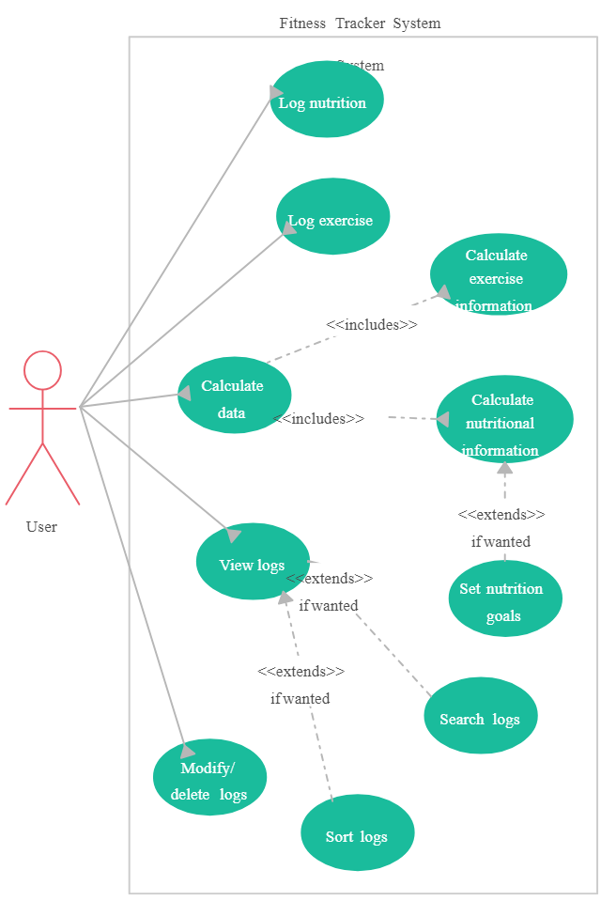
Proposed Architecture

Slide 8
Proposed Architecture
1. User Interface Layer (Presentation):
A GUI screen where users can log a new workout, set fitness goals,
or view their progress.
Example: A window showing a list of completed workouts
with options to add new exercises or set daily step goals.
2. Data Storage Layer (Persistence):
A system that saves user data to a file or database for later retrieval.
Example: A file or database storing workout history and user information, which is updated every time the user logs a new workout.

Slide 9
Proposed Architecture - Description
1.User Interface Layer (Presentation):
Description: Displays data and provides an interface for user interaction, allowing them to log workouts, set goals, and track progress visually.
2. Business Logic Layer (Service):
Description: Handles core application functions like calculating calories burned and managing fitness goals based on user input.
3. Data Storage Layer (Persistence):
Description: Manages storing and retrieving user data, such as workout history, to ensure information is available between sessions.

Slide 10
List of Modules
1. User Module:
Manages user profiles and personal fitness goals.
2. Workout Module:
Handles logging and tracking of workout sessions and exercises.
3. Goal Module:
Manages setting, updating, and tracking progress toward fitness goals.
4. User Interface Module (GUI):
Provides the visual interface for user interaction and data visualization.

Slide 11
Module Description
1. User Module:
Description: This module manages user-related information, such as profile data (name, age, weight, and height) and individual fitness goals. It allows users to create and update their profiles, set personal fitness targets (like weight loss or muscle gain), and adjust their information as needed. This module acts as the central point for customizing the fitness experience to each user's needs.
2. Workout Module:
Description: The Workout Module handles all aspects of exercise tracking. It allows users to log new workouts, including exercise types, duration, intensity, and calories burned. It supports various workout categories, such as cardio, strength training etc.

Slide 12
Module Description (Cont..)
3. Goal Module:
Description: This module is dedicated to managing fitness goals, such as daily step targets, calorie burn goals, or specific workout milestones. Users can set, track, and adjust their fitness objectives, and receive feedback on progress. The Goal Module keeps users motivated by providing updates on goal achievement and suggesting adjustments based on performance.
4. User Interface Module (GUI):
Description: This module provides a visual interface for the application, allowing users to interact easily with features like logging workouts, setting goals, and viewing progress. It handles the design of windows, forms, buttons, and charts, ensuring a user-friendly experience. The GUI Module also manages the flow of information between the user and the application’s core functions, presenting data in an intuitive way.

Slide 13
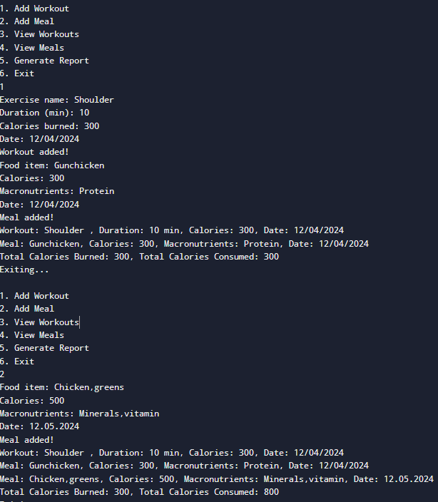
Results and Discussion

Slide 14
Results and Discussion
Results:
User Adoption and Engagement:
The use of fitness tracker applications has rapidly increased, with millions of users worldwide adopting these apps as part of their daily routines. Many users report increased motivation and adherence to fitness goals, such as walking more steps, exercising regularly, or improving sleep patterns.
Discussion:
Fitness tracker applications have undeniably transformed the way individuals monitor their health and fitness. The results indicate that they play an important role in motivating users to maintain healthy lifestyles by setting goals, tracking progress, and providing actionable insights. However, the continued success of these applications depends on several factors, including user engagement and data reliability.

Slide 15
Results and Discussion (Cont..)
Results:
Fitness tracker applications have gained widespread adoption, with users reporting increased motivation and improved health outcomes, such as higher physical activity levels and better sleep. However, user engagement tends to decrease over time, and issues with data accuracy—particularly with tracking steps, calories, and heart rate—remain. Privacy concerns also persist, as users are cautious about how their health data is collected and used.
Discussion:
Fitness trackers are effective in encouraging healthier habits, but their long-term success depends on maintaining user engagement, improving data accuracy, and addressing privacy concerns. While they help users track and improve fitness, the inconsistency in data and the need for stronger security measures can impact trust. Future advancements in technology and better data protection are essential for enhancing user experience and ensuring sustained health benefits.

Slide 16
Conclusion
Conclusion :
Fitness tracker applications have proven to be valuable tools for encouraging healthier lifestyles by helping users monitor their physical activity, sleep patterns, and overall well-being. These apps have demonstrated positive effects on user motivation, leading to improved fitness outcomes. However, challenges such as data accuracy, user retention, and privacy concerns need to be addressed for continued success. By improving technology, enhancing user engagement features, and ensuring robust data security, fitness tracker apps can provide even greater benefits to users and contribute to long-term health improvements.

Slide 17
Thank You
Any queries???

